Slide 1
Robots and Chatbots in the Cloud
All about Azure Internet of Things, Chatbots and the HullPixelbot
Rob Miles
www.robmiles.com

Slide 2
Overview
Creating a robot – HullPixelbot
  Robots and processors
Connecting a robot – Azure IoT Hub and MQTT
  Embedded devices and the Azure IoT Hub
  Message Queue Telemetry Transport (MQTT) and embedded devices
  Sending messages using MQTT
Creating a bot – HullPixebotBot
  A bit about bots
  How to use the Microsoft bot framework
Robot Racing with a Chatbot

Slide 3
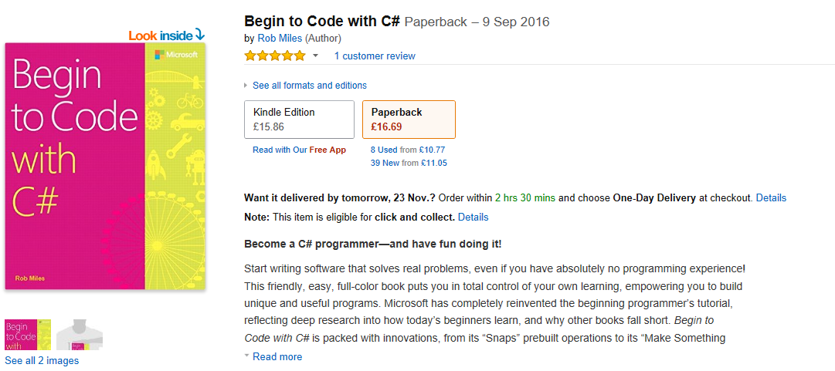
Begin to Code with C#

Slide 4
Building a robot

Slide 5
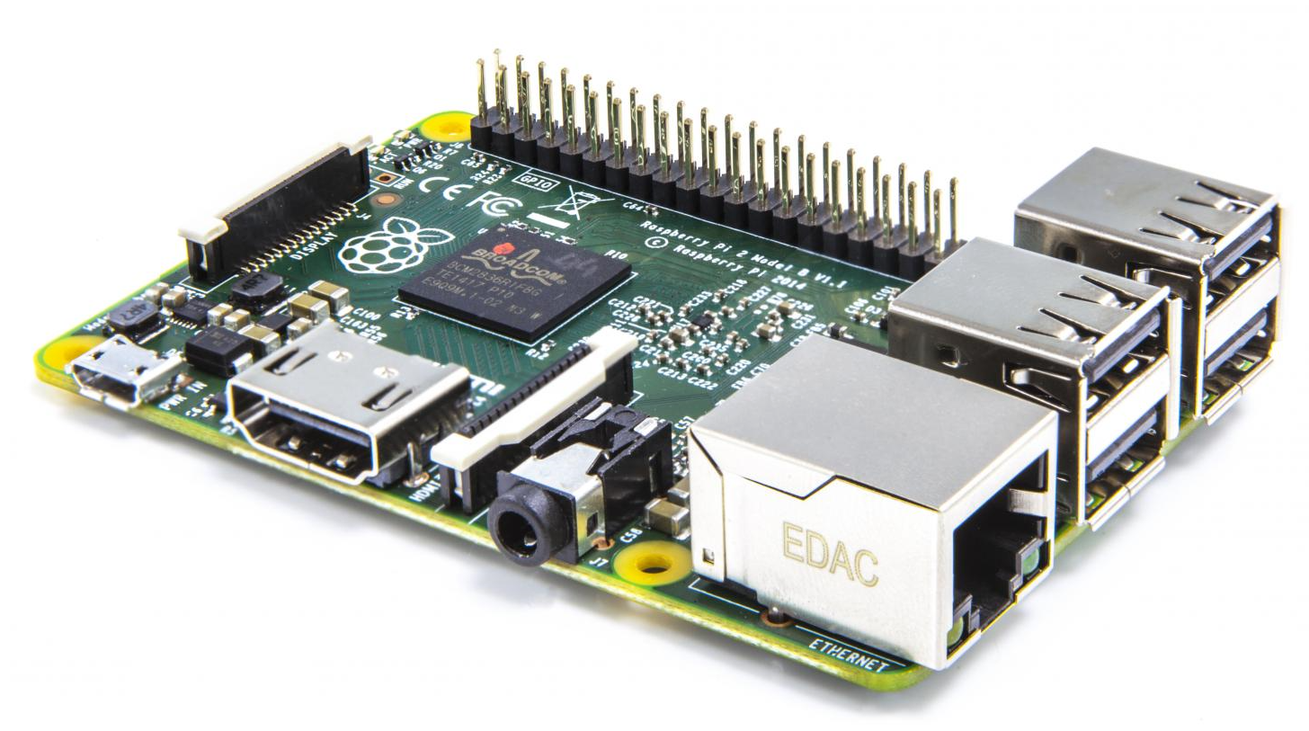
Platforms for a robot
Raspberry Pi
  Advantages:
    Very powerful
    Can run Windows 10 Universal Applications
    Very connected (Bluetooth and WiFi on the Pi 3)
  Disadvantages:
    Takes a while to boot
    Need to be careful about startup and shutdown
    Fairly limited connection options unless you buy an extender board
    Can be expensive once you’ve bought all the bits you need
  The Pi is great as a mid-level device that would sit between your low level sensors and something above (perhaps Azure) but it is too expensive and fragile to be spread around in large numbers

Slide 6
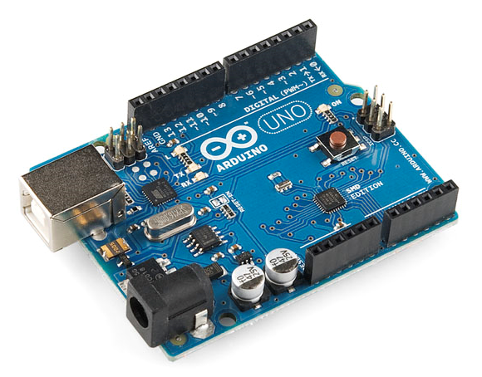
Platforms for a robot
Arduino
  Advantages:
    Really cheap
    Easy to write code
    Plenty of i/o – both analogue and digital
    A proper embedded device
      code runs directly on the hardware
  Disadvantages
    Not that powerful
    Very limited program and data space (32K and 2K)
    No networking ability built in
      you have to use serial connections to transfer information
  The Arduino is fantastic for simple, disconnected devices but is no good for anything that you’d like to connect to the outside world. Very cheap though

Slide 7
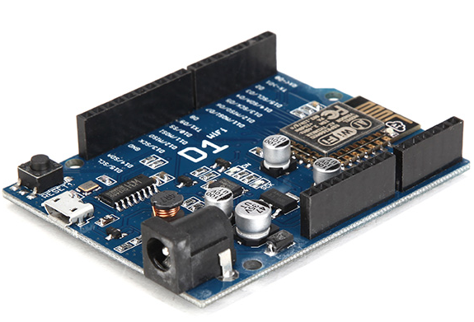
Platforms for a robot
ESP8266
  Advantages:
    Really, and I mean really, cheap
    Easy to write code
    Enough i/o – both analogue and digital
    WiFi built in
      WiFi client
      Access point and server
      Server
  Disadvantages
    Fussy about power supply
    Lots of different versions
    Need to be careful to give the processor time to run the network functions
  This is the “Goldilocks” device. Cheap, networked and easy to program. What’s not to love?

Slide 8
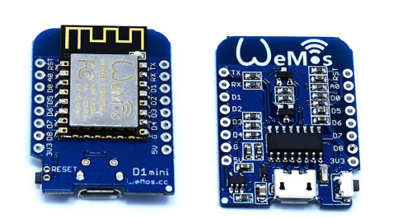
Getting started with the esp8266
Buying hardware
  There are lots of different platform variants
  I really like the “Wemos D2” and D1 mini
    The D1 mini even has a “stackable” architecture
  I buy mine from aliexpress.com
    They can take a while to arrive, but they are post free and startlingly cheap
Writing software
  You can use the free Arduino IDE to write C++ for the esp8266: arduino.cc/
    But this is a fairly horrible experience
  Much better to use Visual Studio via the free VisualMicro plugin: www.visualmicro.com

Slide 9
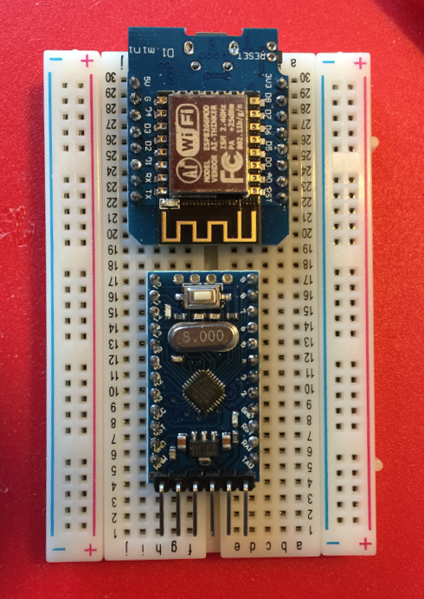
Dual processor robots
Arduino Pro and ESP8266
  One version of the HullPixelbot actually has two processors
    Arduino Pro mini for the input/output and motor control
    Wemos D1 mini for the connectivity
  This is a great way to create i/o heavy devices
    Use a serial connection to pass commands between the two
  For most simple systems you only really need a single device
    But the Arduino Pro mini only costs around a pound….

Slide 10
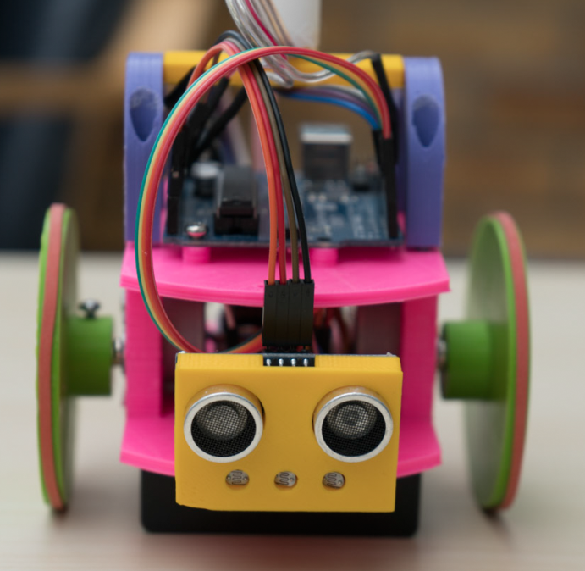
WiFi and the esp8266
Lots of WiFi options
  WiFi client over a serial port
  Fully programmable in C++
  WiFi access point and web server
  Support for UDP, TCP, secure sockets and mDNS
  Very easy to use with many examples
Making a connected client device
  Lots of ways to do this
  We’re going to use MQTT but you can use it as a web sever, or even a WiFi access point (or both)

Slide 11
Azure IoT Hub and MQTT

Slide 12
Message Queue Telemetry Transport
MQTT is a way to connecting sensors to endpoints
  It has a publish/subscribe architecture
The communication can run over serial or WiFi and is based on a simple packet structure
People have different opinions of how good it is, but it is very popular and also supported by the Azure IOT Hub
It also runs (surprise surprise) on the esp8266
It is a great way to create cheap, connected, sensors

Slide 13
Azure, MQTT and the esp8266
MQTT PubSubClient for esp8266
  I’m using the PubSubClient for esp8266 available at https://github.com/knolleary/pubsubclient
  It needs to be modified for Azure:
    Azure uses secure sockets, a different port and has larger packets
    You can find out how to set everything up here:
    http://www.radupascal.com/2016/04/03/esp8266-arduino-iot-hub
Azure IoT Hub
  The Azure IoT Hub will respond to MQTT messages
  These can be passed on to your backend Azure applications and Azure applications can target MQTT devices

Slide 14
Setting up the MQTT server in the esp8266
void setup() {
Serial.begin(9600);
setup_wifi();
client.setServer(mqtt_server, 8883);
client.setCallback(callback);
}
This is the setup function
  It runs when the device starts
  It starts the server running :
    mqtt_server contains the name of the server : HullPixelbot.azure-devices.net
    8883 is the port number being used (this is an Azure thing)
  It also binds a method (callback) to incoming MQTT messages from the server

Slide 15
Making the connection
void reconnect() {
// Loop until we're reconnected
while (!client.connected()) {
Serial.print("Attempting MQTT connection...");
if (client.connect("RedRobot","HullPixelbot.azure-devices.net/RedRobot",
"SharedAccessSignature sr=HullPixelbot.azure-
devices.net%2Fdevices%2redrobot&sig=1zsdfsweraerweeY7lp4Kc1x%2B%2FhVZ7apgGWQQ%3D&se=1")){
Serial.println("connected");
client.publish("devices/RedRobot/messages/events/", “robot started");
client.subscribe("devices/RedRobot/messages/devicebound/#");
} else {
Serial.print("failed, rc=");
Serial.print(client.state());
Serial.println(" try again in 5 seconds");
delay(5000);
}
}
}
  This caches the initial button position so that we detect edges correctly

Slide 16
Decoding incoming messages
void callback(char* topic, byte* payload, unsigned int length) {
int i;
// Display the received message and build a robot command
for (i = 0; i < length; i++) {
message[i] = (char)payload[i];
}
// Put the terminating character on the end of the message
message[i] = 0;
// Pass the command onto the motor processor
sendRobotCommand(message);
}
This method runs when the robot receives a message
The message is passed into the Arduino that controls the robot

Slide 17
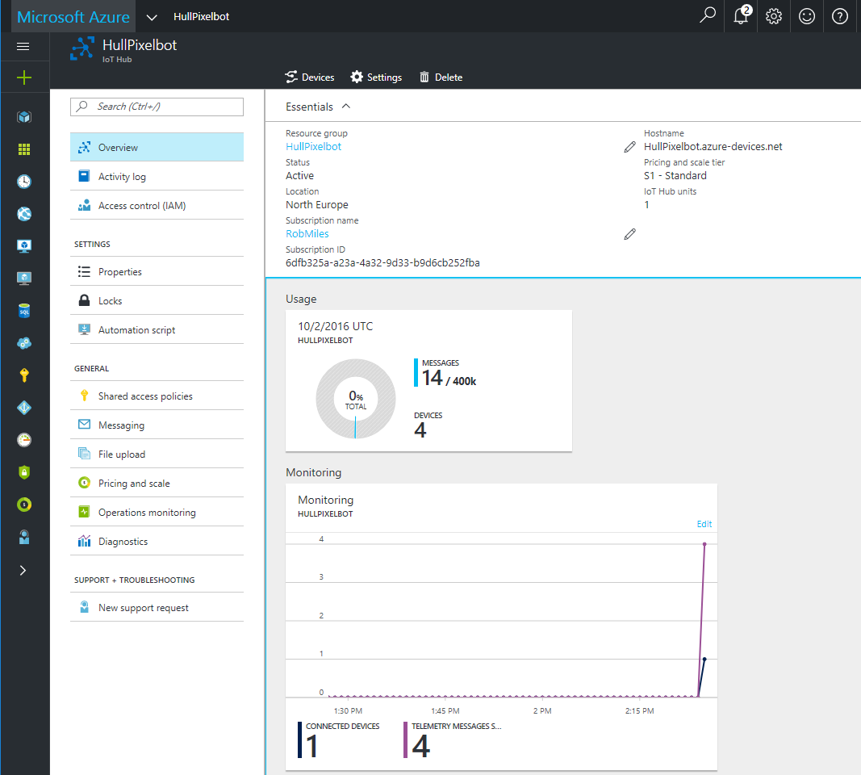
Azure IoT Hub
The IoT hub will collect and manage messages from connected devices
It exposes service points to connect other Azure applications

Slide 18
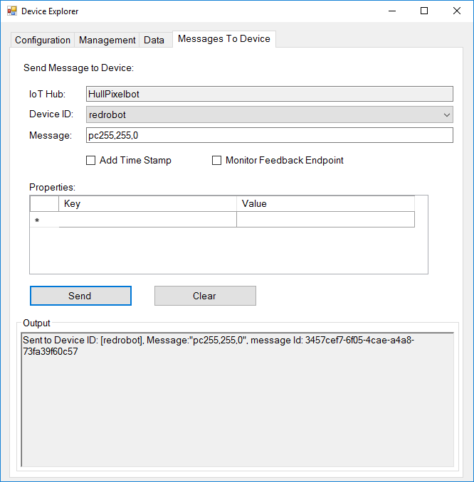
Device Explorer
The device explorer provides device management and testing
We can view messages from connected clients and send messages to them as well
This is not the only way to provision devices
There is also an api you can use to build a workflow if you have lots of devices

Slide 19
Demo 1: Sending messages to the robot
Notes:
Open racingBot
Show the methods
Open Device Explorer
Explain that this is connected to the Azure IoT cloud
Find the RedRobot device
Send the message PC255,0,0
The red robot should turn red

Slide 20
What have we got?
We are half way there:
  We have a cheap robot that we can connect to the cloud
  We have secure endpoints that we can control using MQTT
  This can be the basis of a very cheap set of connected endpoints
Now we need to add the chatbot input

Slide 21
What is a chatbot or “bot”?
Bots are best as dumb devices
  We don’t have humanoid robots helping us do the housework, but we do have washing machines and vacuum cleaners. These are robots that have been specifically designed to perform a simple task
  The same is true when we think about bots. Don’t consider them as “your plastic pal who’s fun to be with”. Think of them as something that you can use to book a flight, reserve a game or ask about the weather.
Bots can have buttons
  Don’t think of a bot as something that only uses natural language. A lot of the time users aren’t going to want the overhead of typing “I’d like to reserve a game please”. They’d much rather just press a button labelled “Reserve”
Bots must be helpful rather than human
  A bit of humanity is a good idea, but it is much more useful if the bot can respond in a helpful way when it fails to understand what is going on

Slide 22
Making bots
A bot as a data processor
  In its simplest form a bot is takes something in, does something with it, and then produces an output
  This is a classic model of a computer. When we look at the bot framework in a minute we’ll see something that lets us take something and push back a reply
Bots and Wizards
  A good way to regard a bot is as a wizard that guides the user through a process. When you are booking a haircut or changing your password you don’t want conversation, just a particular outcome. Considering it this way and recognising the importance of context will make for great bots.
You don’t need to understand natural language
  You can get a long way with Regular Expressions or just simple text analysis.
Context is key
  A crucial way to improve your bot is to have it maintain context during the conversation. So that when the user says “it” meaning “the book I’m buying” you can respond sensibly.

Slide 23
Clever Bots
You can make clever bots with LUIS
  The LUIS (Language Understanding Intelligent Service) can be used to improve how well your bot understands natural language
  It adds voice control
  You can train LUIS to work in your particular context
You can make bots that have empathy with their users
  There are even tools that let your bot determine how happy your user is – so that you can automatically escalate a conversation
  We’re not going to do anything like that though, we are just going to take in text, do something with it and then send back a response

Slide 24


Microsoft bot framework architecture
Bot connector
Your bot’s web service
The Bot connector provides the glue
  Your bot sits behind a url and talks to the bot services
  The services then connect to a range of different connection technologies to provide the required interaction
  The connector manages the conversion of the conversation type to the channels

Slide 25
Bot Options
C# and .NET
  Write C# applications that look a lot like asp pages
JavaScript and Node
  Embed in web page using JavaScript and Node
REST API
  Create restful calls from any device that you fancy
Getting Started
  https://dev.botframework.com/
  https://docs.botframework.com/en-us/csharp/builder/sdkreference/gettingstarted.html

Slide 26
Bot Options
C# and .NET
  Write C# applications that look a lot like asp pages (what we are going to do)
JavaScript and Node
  Embed in web page using JavaScript and Node
REST API
  Create restful calls from any device that you fancy
Getting Started
  https://dev.botframework.com/
  https://docs.botframework.com/en-us/csharp/builder/sdkreference/gettingstarted.html

Slide 27
Creation overview
Create the Visual Studio project
Register the bot with the Bot Framework
Write your code with the Bot Emulator
Deploy the bot code to the cloud
Publish the bot with the selected channels
Use the bot

Slide 28
Bot beginnings
You can build a bot as raw code
You can use FormFlow to build a dialog
Bots can be text based, but your conversation can include images, dialogs and automatically call out to other services as required
  Perhaps make a Skype call to a real person if the bot can’t handle the request

Slide 29
1. Create Visual Studio Project

Slide 30
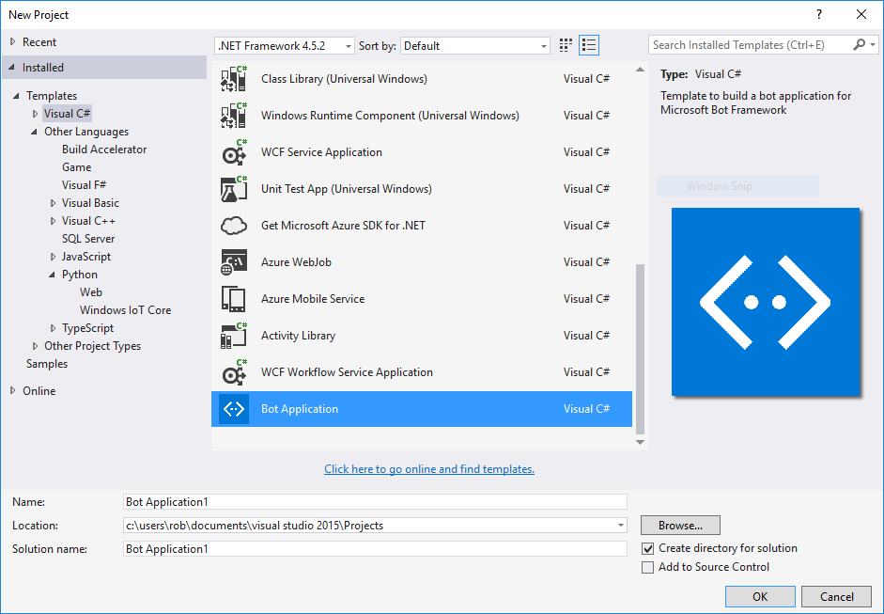
The Bot Template
Download the framework
  Use Visual Studio 2015 (works with community edition)
  Delivered in the form of a project template
  Presently no visx installer
  Project template stored on GitHub
  All open source
  Copy to your Visual Studio templates folder:
    \Documents\Visual Studio 2015\Templates\ProjectTemplates\Visual C#\
  Make a new C# project from the template

Slide 31
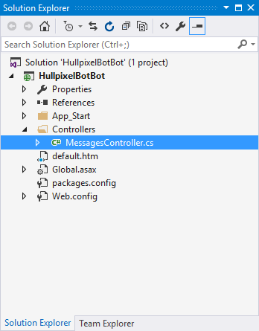
Make a project
A Bot project looks a lot like an ASP page
It provides an endpoint and controllers
Our code runs when the user sends us a post

Slide 32
2. Register the bot

Slide 33
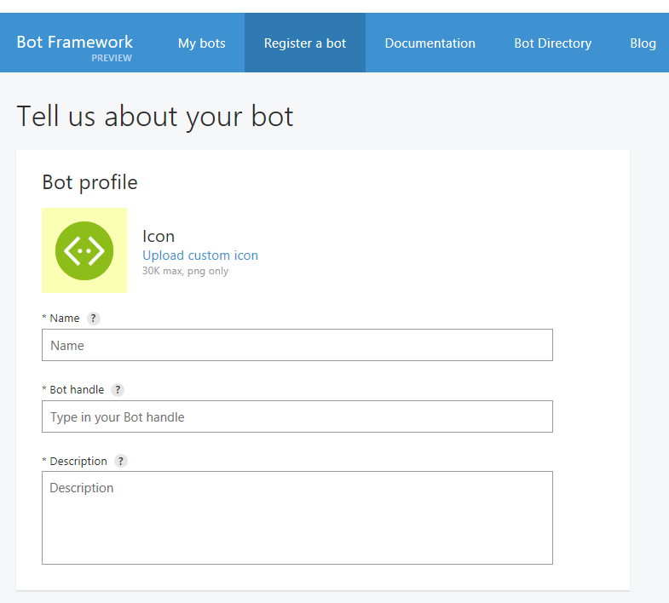
Registering a Bot
Eventually we want to publish the bot
  For this it needs an identity in the Bot Framework
  This is a bit like publishing an application
Name for directory
Handle for chats
Description

Slide 34
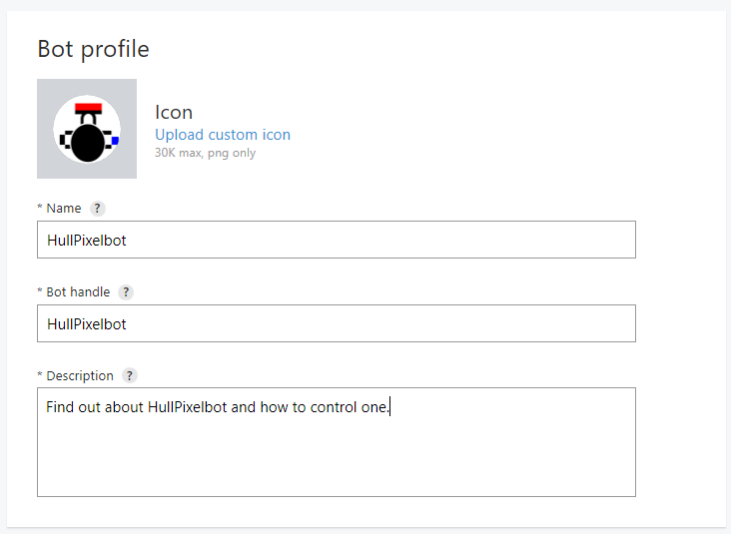
Give the details
  You give the bot an icon and an identity in the system
  You also give it some description text which will appear in the bot directory
Name for directory
Handle for chats
Description

Slide 35
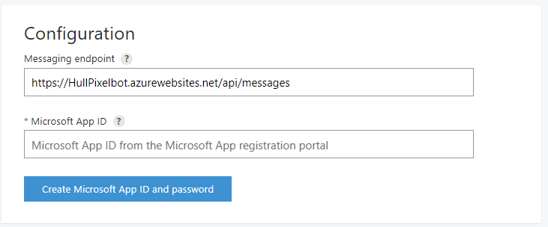
Endpoint
Messaging endpoint
Now we set the Messaging endpoint for our bot
This will be bound to the Post request that we saw behind the bot activity
  We’ll make an Azure site at this address to provide the bot service

Slide 36
App ID
Create App ID
Next we create the App ID and App Secret (password)
  These are used to make sure that the code we create behind the URL is actually the droid we are looking for
  The information is placed in the web.config file of the bot application

Slide 37
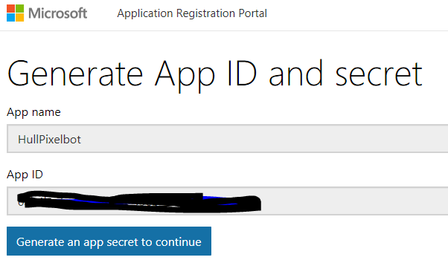
App ID and Secret
  The App ID is fixed and the handle by which the app will be known
  You can generate a new Secret if you ever need one (forgot or compromised)

Slide 38
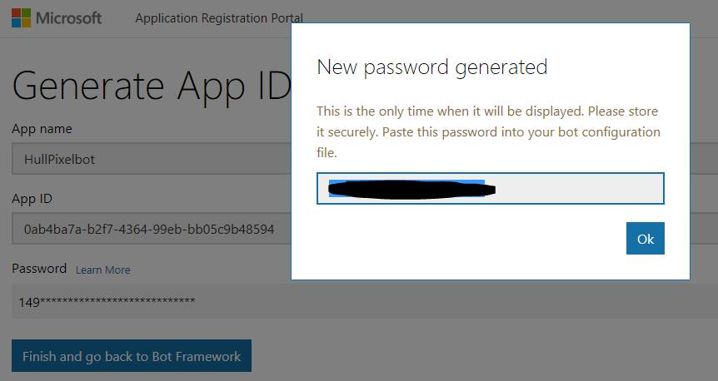
App ID and Secret
  The App ID is fixed and the handle by which the app will be known
  You can generate a new Secret if you ever need one (forgot or compromised)

Slide 39
Web config in the app
<appSettings>
<!-- update these with your BotId, Microsoft App Id and your Microsoft App Password-->
<add key="BotId" value="HullPixelbot" />
<add key="MicrosoftAppId" value="0sdfsdfsdwerwwwnotmefolks4456--99eb-bb05c9b48594" />
<add key="MicrosoftAppPassword" value="149miCfsdf7s6dvJjZyz4CaU" />
</appSettings>
Once you have your keys you can add them to the Web.config file in your solution
The bot will run locally without them, but it can’t be deployed

Slide 40
3. Write your code with the Bot Emulator

Slide 41
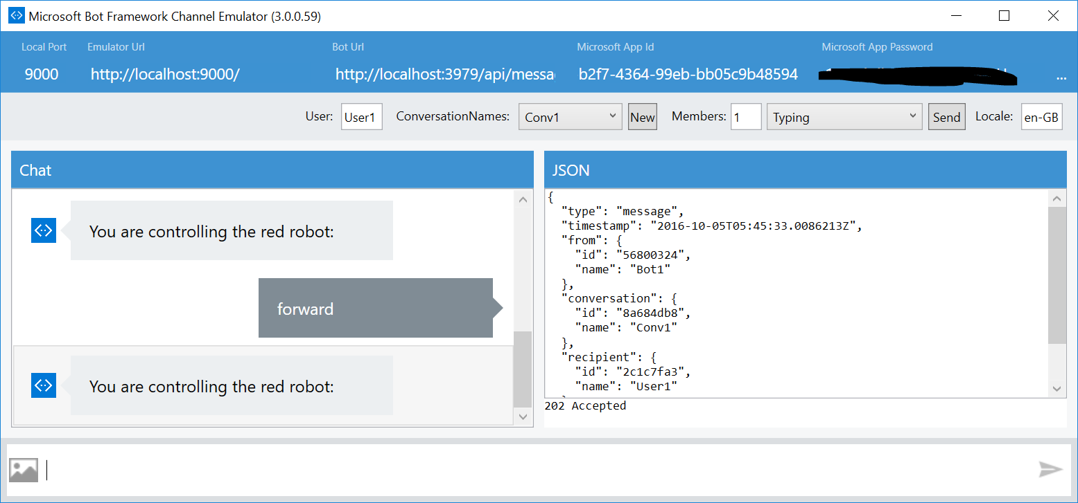
Bot Emulator
The Bot emulator is a free download
It connects to the bot endpoint and can be used to create and manage conversations

Slide 42
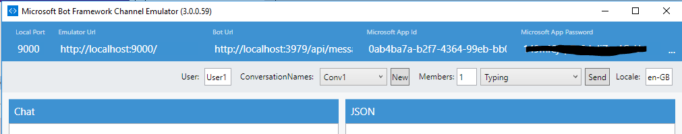
Emulator Configuration
We need to give the bot the app ID and password (secret) to allow it to connect
These are retained by the bot

Slide 43
Emulator Configuration
We need to give the bot the app ID and password (secret) to allow it to connect
These are retained by the bot
Make sure the endpoint address agrees with your app

Slide 44
It’s in the Post
public async Task<HttpResponseMessage> Post([FromBody]Activity activity)
{
if (activity.Type == ActivityTypes.Message)
{
ConnectorClient connector = new ConnectorClient(new Uri(activity.ServiceUrl));
// calculate something for us to return
int length = (activity.Text ?? string.Empty).Length;
// return our reply to the user
Activity reply = activity.CreateReply($"You sent {activity.Text} which was {length} characters");
await connector.Conversations.ReplyToActivityAsync(reply);
}
else
{
HandleSystemMessage(activity);
}
var response = Request.CreateResponse(HttpStatusCode.OK);
return response;
}
This is the entire Post method from the default project

Slide 45
Handling System Messages
A system message is concerned with the state of the conversation itself
In the sample app the system message are handled by a separate method which responds to each message type appropriately
  User has left, delete their data
  New members added to or removed from the conversation
  User is typing
  We’ve been pinged

Slide 46
Keeping Active
The Activity class represents the message that was received and provides context information
The basic Chatbot just uses the text that was entered into the message
The Activity class can be used to drive a Dialog instance
My focus at the moment is on sending simple commands to my robots

Slide 47
Demo 2: Talking to HullPixelbotBot
Notes:
Open Visual Studio
Open HullPixelBotBoot
Set a breakpoint on the first statement of the Post method
Run it
Start the bot Emulator
Enter a command
Note that the breakpoint is hit
Show how it is processed

Slide 48
4. Deploy your bot to the cloud

Slide 49
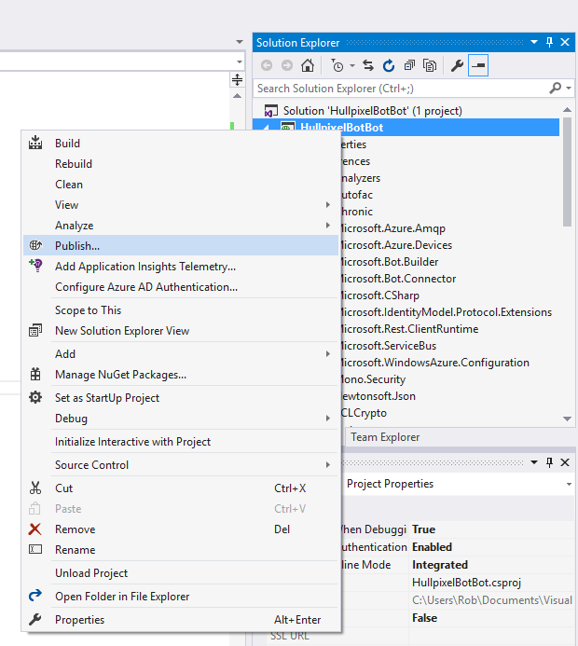
Hosting your bot code
You can host your bot code anywhere you like
  But publishing to Azure is really easy ☺
Once you have your endpoint you configure your bot to point to that, and away you go

Slide 50
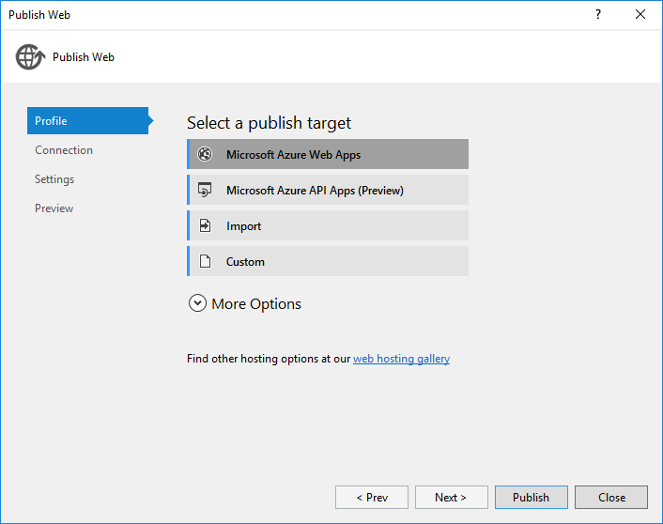
Publish target
Decide where the bot is going to be hosted

Slide 51
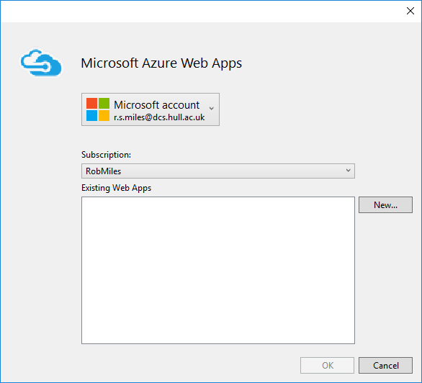
Azure Web Apps
Make a new web app

Slide 52
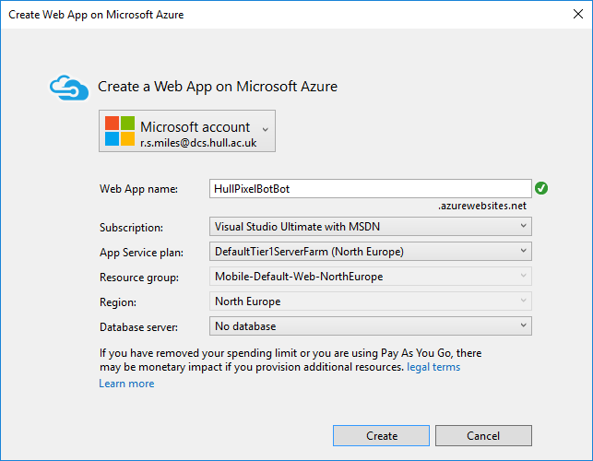
Configure the app
Select the service plan and the regions for your app
Give the app a name that matches the endpoint for your bot
  Although you can change this later if you get it wrong – like I did

Slide 53
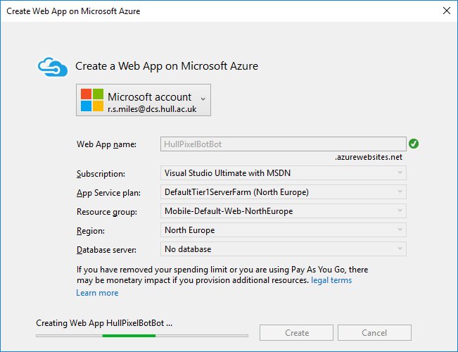
Deploy
Deploying the bot takes a surprisingly short time

Slide 54
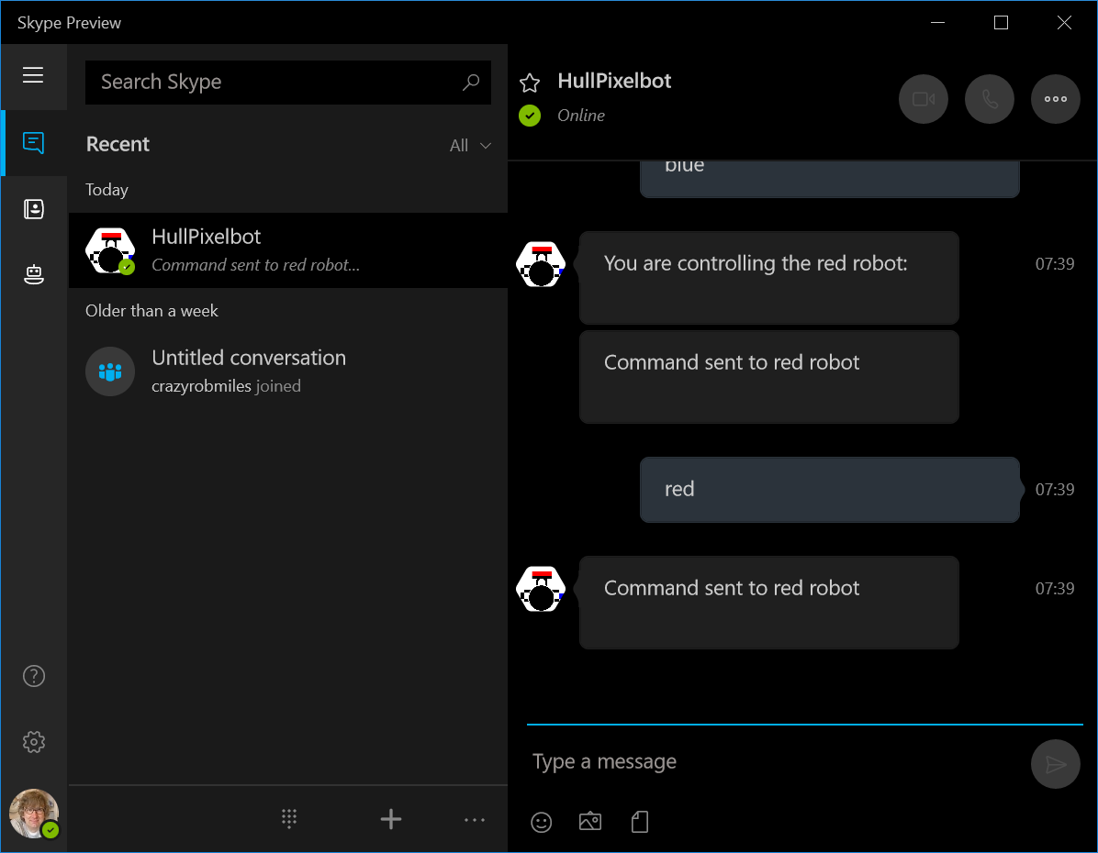
HullPixelbot on Skype
This is the HullPixelbot on Skype
You can use it to send commands to the robot
Note that this is not publicly available yet

Slide 55
4. Publish your bot

Slide 56
Bot publishing
Before a bot is made publicly available you need to publish it
The button is hidden on the above screenshot
  Sorry about that
Only after the bot has been approved is it added to the bot directory
  But you can still test it locally on your Skype account

Slide 57
5. Use the bot

Slide 58
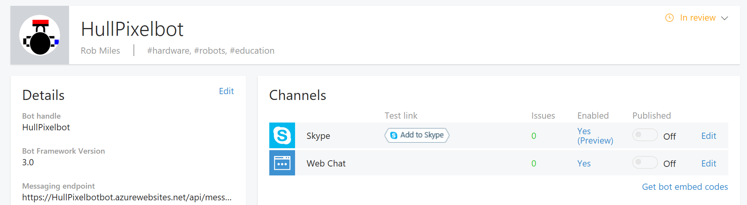
Bots and channels
By default your bot is visible on two channels
The Skype channel will only work once the bot has passed approval
  The Web Chat client does work however

Slide 59
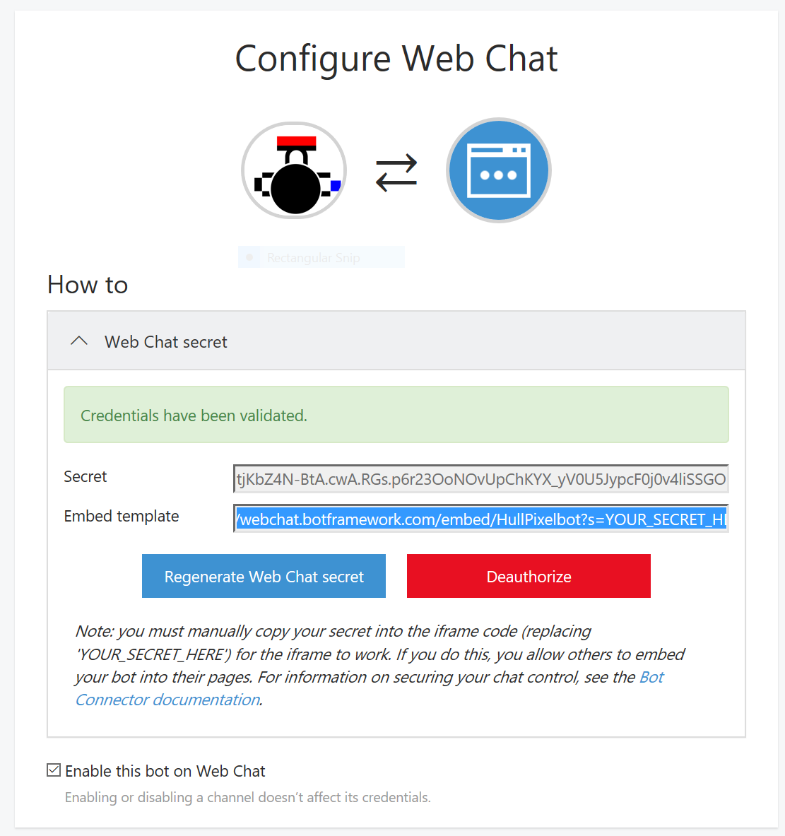
Making a web chat
The web chat provides an iFrame that you can drop into any web page
The HTML contains a Secret which you need to embed into the iFrame

Slide 60
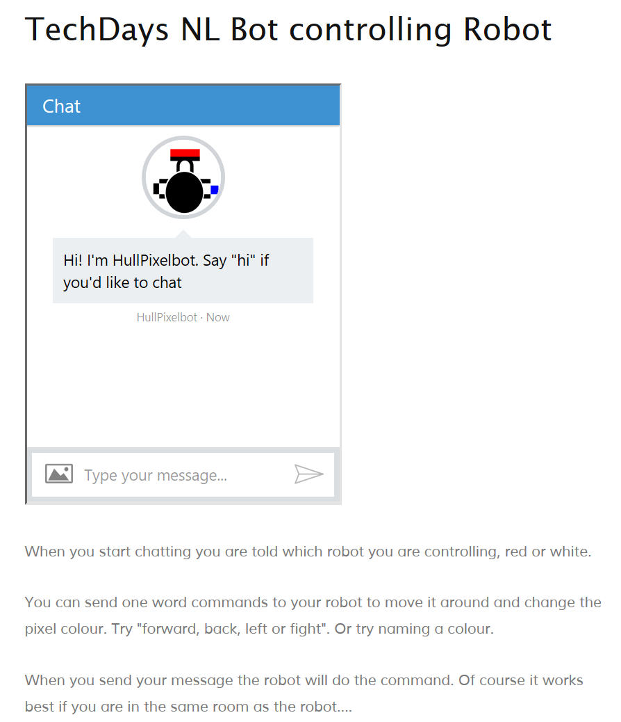
HullPixelbot web chat
If you go to hullpixelbot.com you can find the web dialog we will be using to control the robot

Slide 61
Linking bots to robots

Slide 62
Robot devices
The bot will need to talk to a robot
To do this we have to give the robot an identity on MQTT and then talk via this to the device

Slide 63
Making a device endpoint
You can create a device and add it to the Azure IoT hub using the Device Explorer program
This also generates the keys that the device will use to authenticate the connection
If you have a large number of devices this can be performed programatically

Slide 64
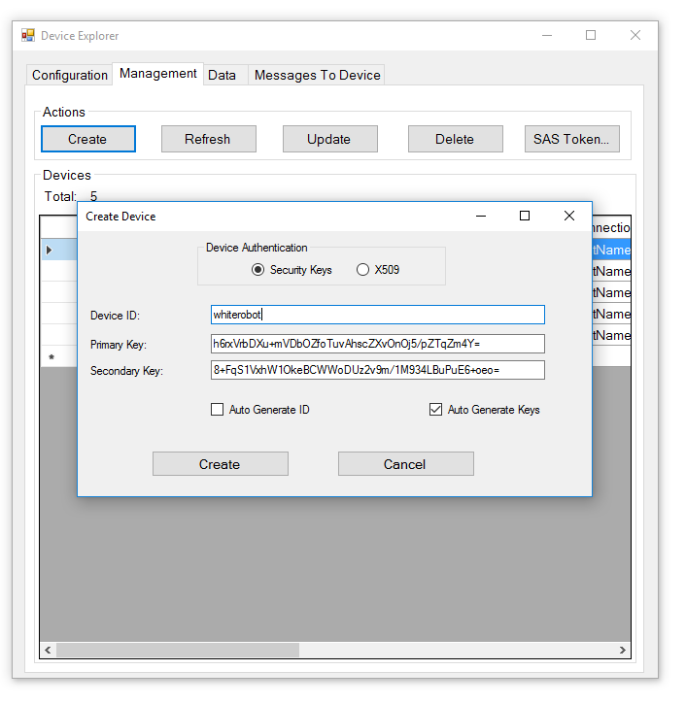
Creating a device
You can create devices using the Device Explorer program
This will produce a key that can be used by the esp8266 app to connect to the IoT Hub

Slide 65
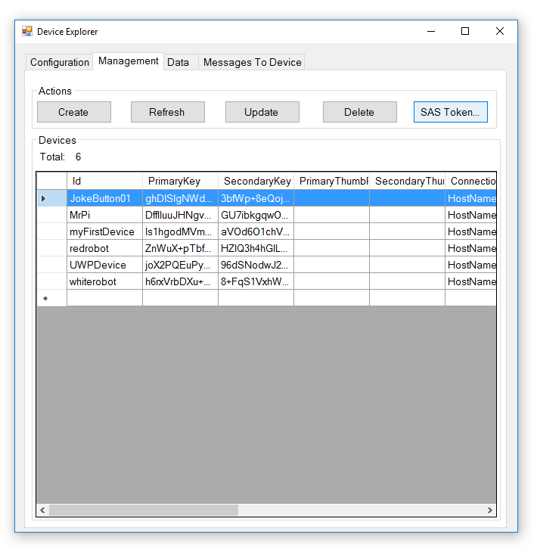
Connection string
Once you have the device you can get the SAS token to use in the connection string
This needs to go inside the exp8266 code to set up the connection

Slide 66
Cloud to device
Once we have our devices we need to communicate with them from our bot application
There are some sample programs that make this very easy:
  https://azure.microsoft.com/en-us/documentation/articles/iot-hub-csharp-csharp-process-d2c/
  https://azure.microsoft.com/en-us/documentation/articles/iot-hub-csharp-csharp-c2d/

Slide 67
Sending a message to the bot
static ServiceClient serviceClient = null;
static string connectionString = "HostName=HullPixelbot.azure-devices.net;SharedAccessKeyName=iothubowner;SharedAccessKey=3l6MBea3c9YyIkWO9JRU6CKGi8=";
private async static Task SendCloudToDeviceMessageAsync(string host, string message)
{
if(serviceClient==null)
serviceClient = ServiceClient.CreateFromConnectionString(connectionString);
var commandMessage = new Message(Encoding.ASCII.GetBytes(message));
await serviceClient.SendAsync(host, commandMessage);
}
The method assembles the message into a byte array and then sends it out of bot
  This version is not acknowledged

Slide 68
Getting connected
It’s slightly more complicated than this explanation
  There are some packages that you need to add from nuget
But it’s not that difficult
At the moment I’m only sending messages from cloud to device, but you can also send them the other way…

Slide 69
Summary
We have seen how to create an embedded device, and what an awesome platform the esp8266 is when linked to the Azure IoT Hub
Wwe have taken a look at the Azure IoT Hub and how a device can use MQTT to connect to this
We have seen that chatbots are great for automating simple tasks
  They provide an alternative UI for services
Bots are essentially web services
  But you register them in the bot directory and there is an approvals process
It is easy to send messages from Cloud apps into devices attached to the IoT Hub

Slide 70
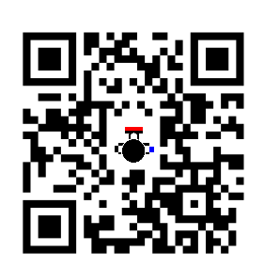
Robot Fun…….
I have 7 robots that we can play with
We can drive them round via the hullpixelbot chat application
We can also run all the programs together
hullpixelbot.com

